Slide 1

REAL STATE MANAGEMENT SYSTEM

Slide 2
PROJECT TITLE: REAL ESTATE MANAGEMENT SYSTEM
Project Supervisor: Mrs.R.LALITHA M.E
Name of the Student: D.V.MAHESH BABU
Register Number: 40110287

Slide 3
ABSTRACT
Real Estate Management System – is an Estate Agent and Property Management System is a user friendly contact and property manager for real estate professionals. Save time and sell more by empowering to easily keep track of leads, manage listings, and market to new prospects.
Real Estate Management System is complete end to end solution to cover all aspects of Estate Agent day to day activity and Property buying selling procedure for small and large organization.

Slide 4
Purpose -
This website is an Online real estate business website through which a user can access its information and manage all the adding, updating, deleting the assets and some of its tasks.
The Admin user can change the update the information regarding property selling and buying and cancellation. The system is very useful for the companies who developed apartments, hotels, villa, residential properties and commercial properties. Companies or individual agents can also advertise their property.

Slide 5
Scope -
The real of World Wide Web have spread across millions of household, so naturally, Internet has become by far the best platform for real estate marketing today.
Now days when everything is online, how is it possible that real estate left web application behind. There are lots of real estate companies who advertise their property online so idea behind developing this application is that their property can also sell, or buy rental property using this. These applications are not widely popular but in future, they have large scope of growth.

Slide 6
Objective
The system should have a login. A login box should appear when the system is invoked.
The Admin should have all the type of authority.
The Admin should maintain property .Admin identify property type as it is residential or commercial property.
The Admin user can inform their agents for regarding to property and update the information regarding property and cancellation of property or changing buyer choice.

Slide 7
Project Goals -
Planned approach towards working: - The working in the organization will be well planned and organized. The data will be stored properly in data stores, which will help in retrieval of information as well as its storage.
Accuracy: - The level of accuracy in the proposed system can not be decided. Because here user buy and another user build the home. There is no guarantee.
Reliability: - The reliability of the proposed system will be high due to the above stated reasons. The reason for the increased reliability of the system is that now there would be proper storage of information.

Slide 8
Project Goals -
Planned approach towards working: - The working in the organization will be well planned and organized. The data will be stored properly in data stores, which will help in retrieval of information as well as its storage.
Accuracy: - The level of accuracy in the proposed system can not be decided. Because here user buy and another user build the home. There is no guarantee.
Reliability: - The reliability of the proposed system will be high due to the above stated reasons. The reason for the increased reliability of the system is that now there would be proper storage of information.

Slide 9
Project Modules -
Real Estate Management System is a project which provides the facility where users can easily buy, sale and rent their properties such as land, houses and shops. In this project we use PHP and MySQL database. It has two modules.
Admin Module
User Module
Property Owner
Broker
Buyer(Simple user)

Slide 10
Admin Modules:
Dashboard: In this section, admin can see all detail in brief like total property type, total country, total state, total city, total agent, total owner, total buyer(user) ant total property listed.
Property Type: In this section, admin can manage property type (add/update).
Country: In this section, admin can manage country (add/update).
State: In this section, admin can manage state (add/update).
City: In this section, admin can manage city (add/update).

Slide 11
Admin Modules: (Continue)
Owner: In this section, admin can view the detail of owners.
Agents: In this section, admin can view the detail of agents.
User: In this section, admin can view the detail of user.
List of properties: In this section, admin can view details of property listed,
Reviews: In this section admin, can view reviews and also approved, disapproved and delete the reviews which is given by users.
Pages: In this section, admin can manage about us and contact us pages.
Search Property: In this section admin, can search the listed property by its property id, name and mobile number.

Slide 12
User Modules:
Property Owner
a. User Profile
In this section owner do the following activity
i. Edit Profile: Owner can edit his/her own profile.
ii. Change Password: Owner can change his/her own password.
Iii.Add Property: Owner can add his/her own property.
iv. My Properties: Owner can see his/her own listed properties.

Slide 13
User Modules:
Property Owner
v. Received Enquiries: Owner can view receive enquiries against his/her own listed properties and also answer the enquiries.
vi. Answer Enquiries: Owner can views answer enquiries.
vii. Logout: Owner can logout from own account.
b.Change Password: Owner can change his/her own password.
c. Logout: Owner can logout from own account.

Slide 14
User Modules:
Agents
User Profile
In this section Agents do the following activity
i.Edit Profile: Agents can edit his/her own profile.
ii. Change Password: Agents can change his/her own password.
iii.Add Property: Agents can add his/her own property.
iv.My Properties: Agents can see his/her own listed properties.

Slide 15
User Modules:
Agents
V.Received Enquiries: Agents can view receive enquiries against his/her own listed properties and also answer the enquiries.
Vi.Answer Enquiries: Agents can views answer enquiries.
vii.Logout: Agents can logout from own account.
b.Change Password: Agents can change his/her own password.
c. Logout: Agents can logout from own account.

Slide 16
User Modules:
Buyer
Home Page: User can view the home page of the real estate management system
About: User can view about us page.
Properties: User can view properties they can view property type wise, Status wise and city wise and put his/her enquiries against any property
Contact us: User can view contact us page.

Slide 17
SOFTWARE USED
XAMPP(Apache Mysql Php)
NOTEPAD++ OR ANY OTHER TEXT EDITOR
CHROME OR ANY OTHER BROWSER

Slide 18
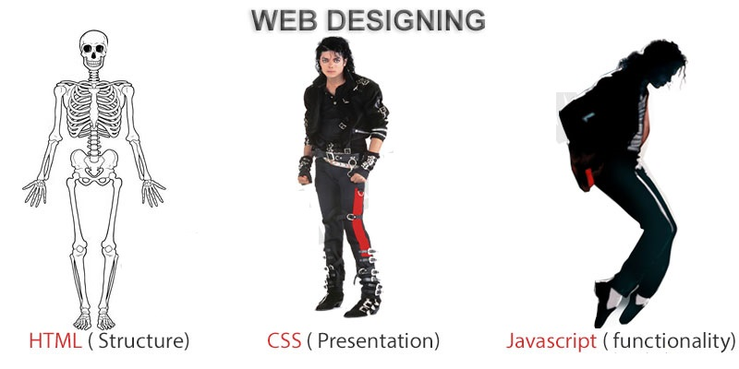
FRONTEND (LANGUAGE USED)
HTML (HYPERTEXT MARKUP LANGUAGE)
CSS (CASCADING STYLE SHEET)
BOOTSTRAP (FRAMEWORK OF CSS AND JS)

Slide 19

BackEnd Technologies Used
PHP(Hypertext Preprocessor)(Server Side Language)
MYSQL(Database)

Slide 20
SYSTEM DESIGN
Unified Modeling Language:
UML stands for Unified Modeling Language. It is a third generation method for specifying, visualizing and documenting the artifacts of an object oriented system under development. Object modeling is the process by which the logical objects in the real world (problem space) are represented (mapped) by the actual objects in the program (logical or a mini world). This visual representation of the objects, their relationships and their structures is for the ease of understanding. This is a step while developing any product after analysis.

Slide 21
The Unified Modeling Language encompasses a number of models.
Use case diagrams
Class diagrams
Sequence diagrams

Slide 22
Use Case Diagram:
Use case diagram consists of use cases and actors and shows the interaction between them. The key points are:
The main purpose is to show the interaction between the use cases and the actor.
To represent the system requirement from user’s perspective.
The use cases are the functions that are to be performed in the module.
An actor could be the end-user of the system or an external system.

Slide 23
Use Case Diagrams – User :
Signup
Sign in
View Properties
Enquiry on Properties/
View Enquiries
Change Password
Update Own Profile

Slide 24
Use Case Diagrams – Broker/Owner:
Signup
Sign in
My Account
Manage Properties (Add/ Edit)
Manage Enquiries(Answers/ Unanswered)
Update Own Profile
Change Password
Password Recovery

Slide 25
Use Case Diagram - Admin
Signin
Manage Property Type(add/Edit)
Manage State(Add/ Edit)
Manage City(Add/ Edit)
View Agent/ Owner / User Details
View Properties
Manage Reviews (Approve / Unapproved)
Search Properties

Slide 26
Sequence Diagram:
The purpose of sequence diagram is to show the flow of functionality through a use case. In other words, we call it a mapping process in terms of data transfers from the actor through the corresponding objects.

Slide 27
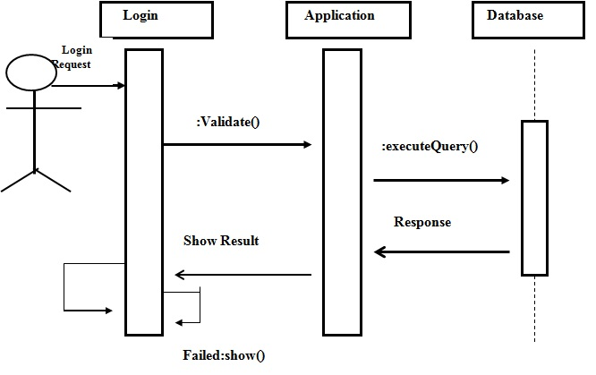
Sequence Diagram For Administrator:-

Slide 28
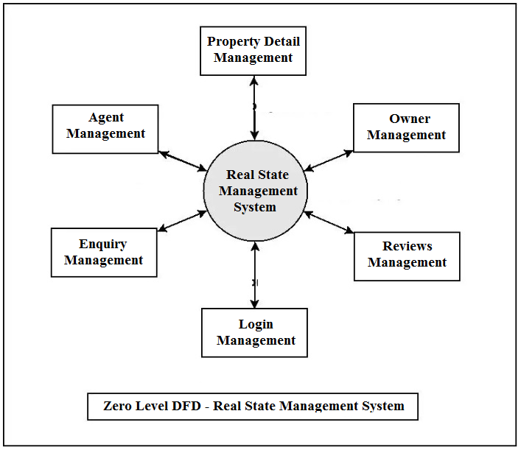
System Architecture/ Ideation Map

Slide 29
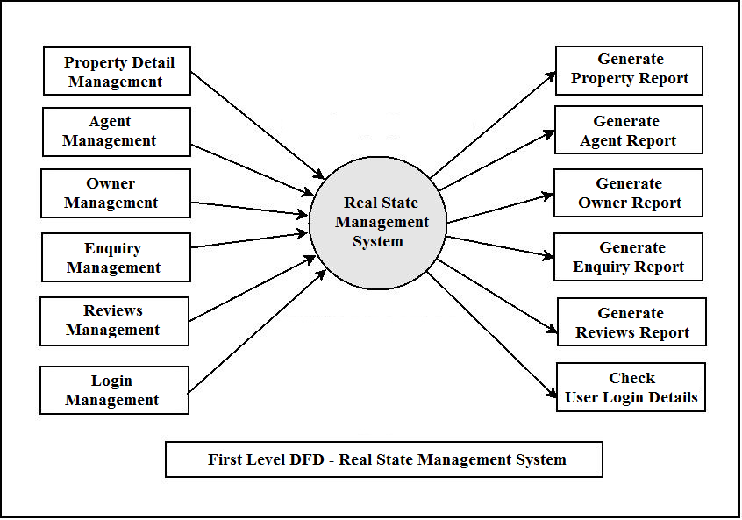
Data Flow Diagram(DFD)

Slide 30
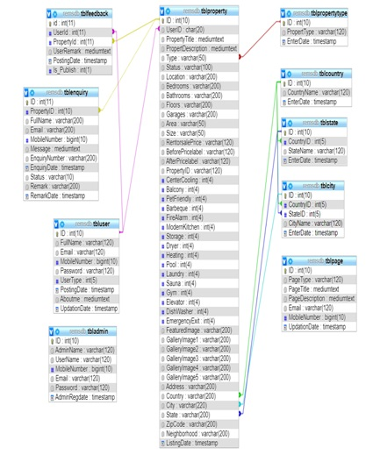
Class Diagram

Slide 31
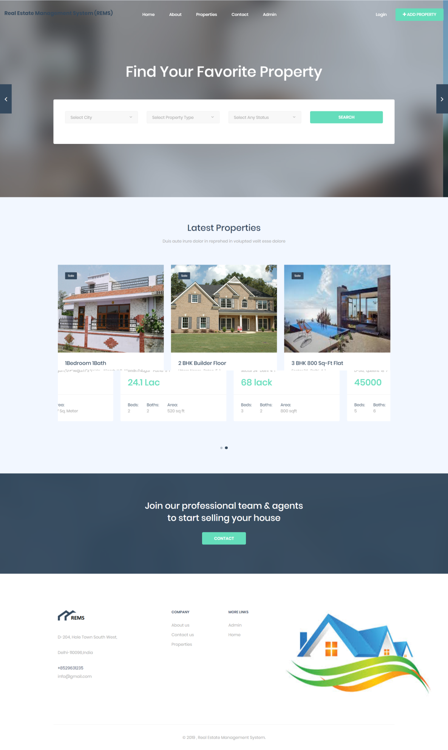
SCREEN SHOTS – Home Page

Slide 32
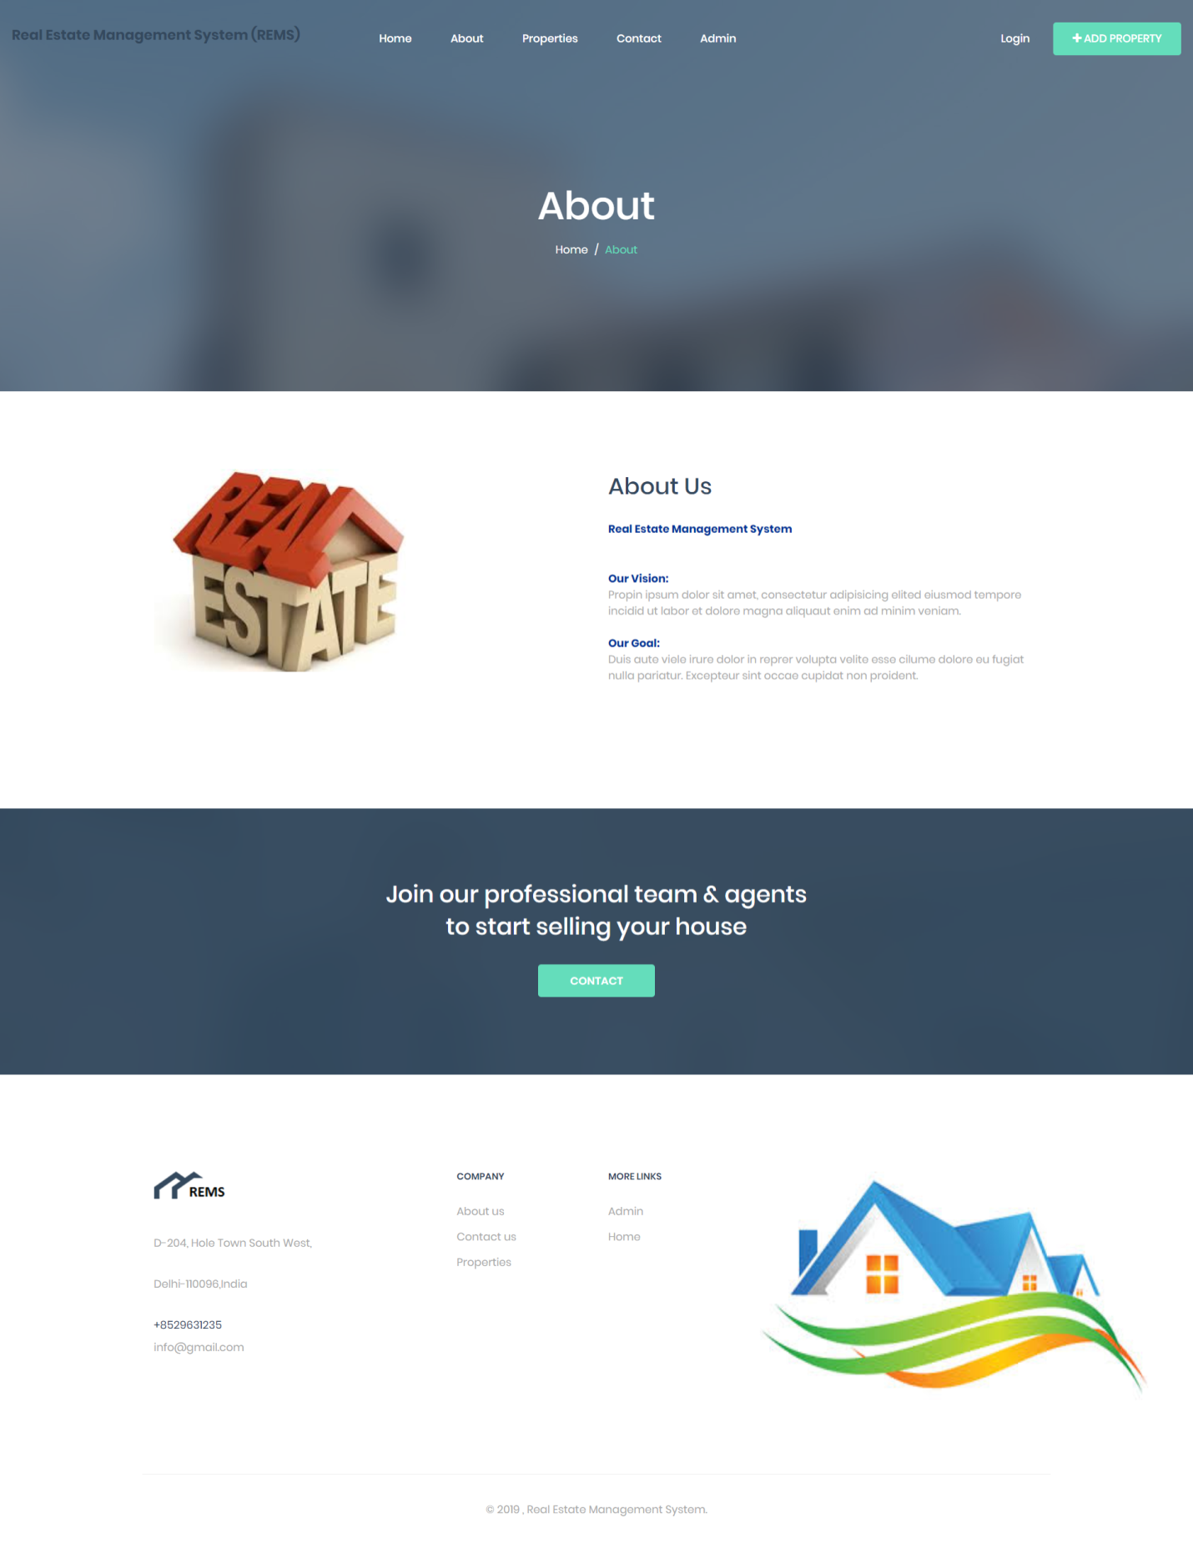
About Us Page

Slide 33

CONTACT US PAGE

Slide 34
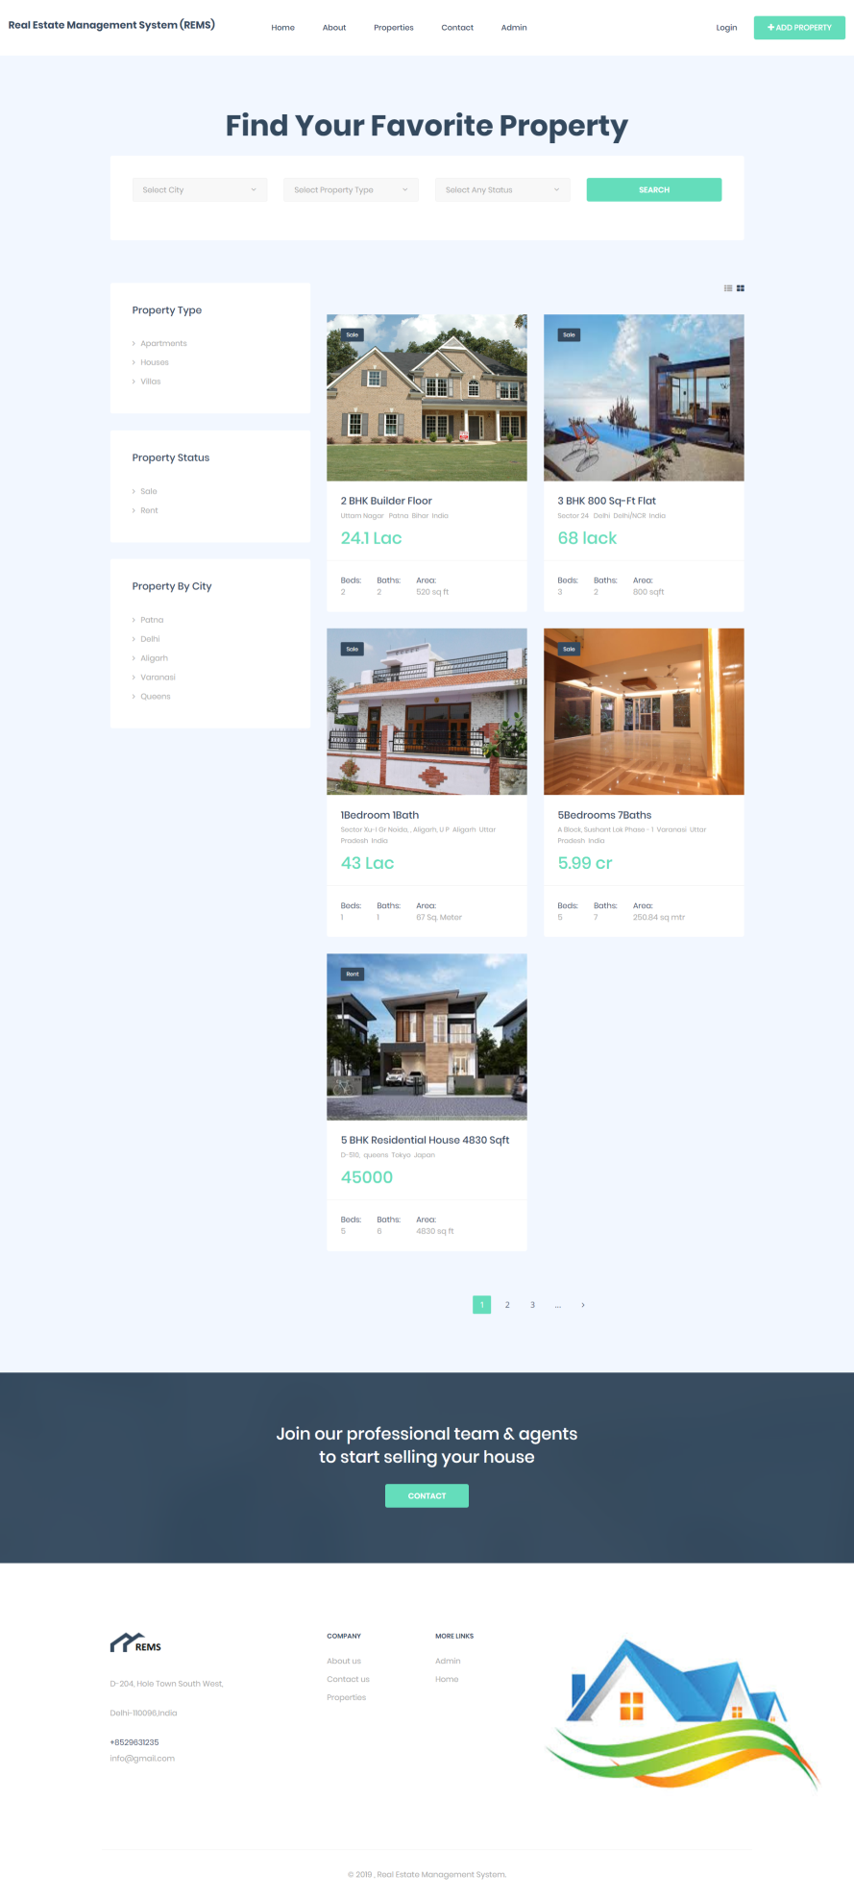
PROPERTY PAGE

Slide 35
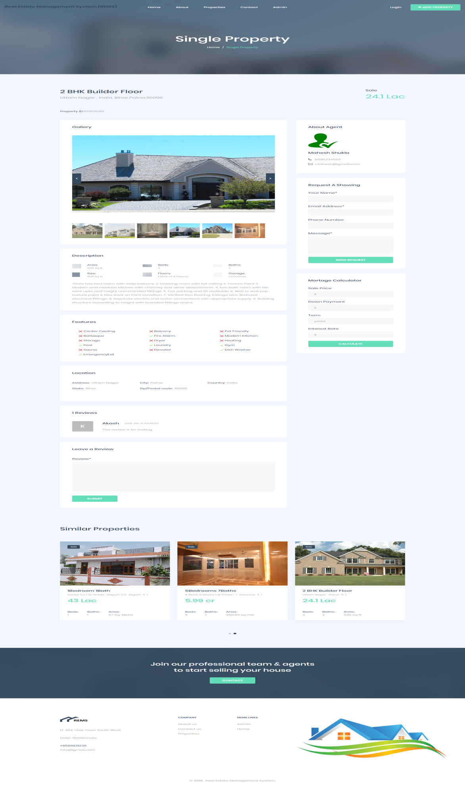
PROPERTY DETAIL PAGE

Slide 36
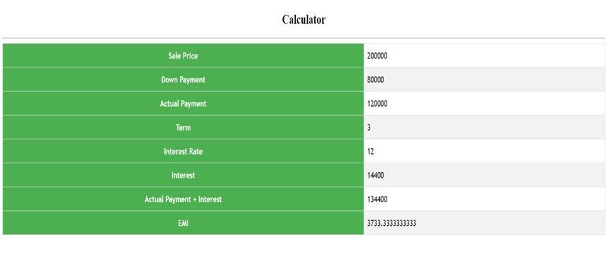
MORTGAGE CALCULATION PAGE

Slide 37
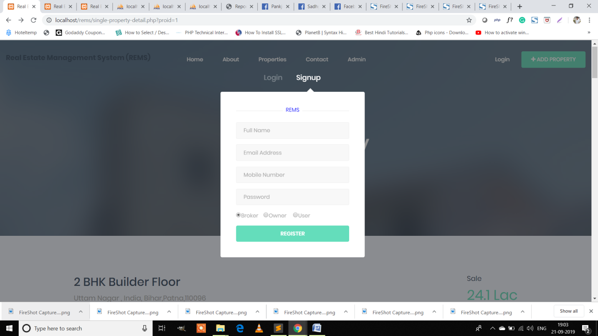
USER REGISTRATION PAGE

Slide 38
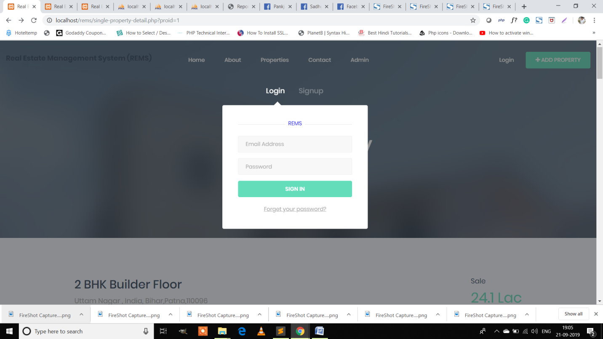
User Login Page

Slide 39
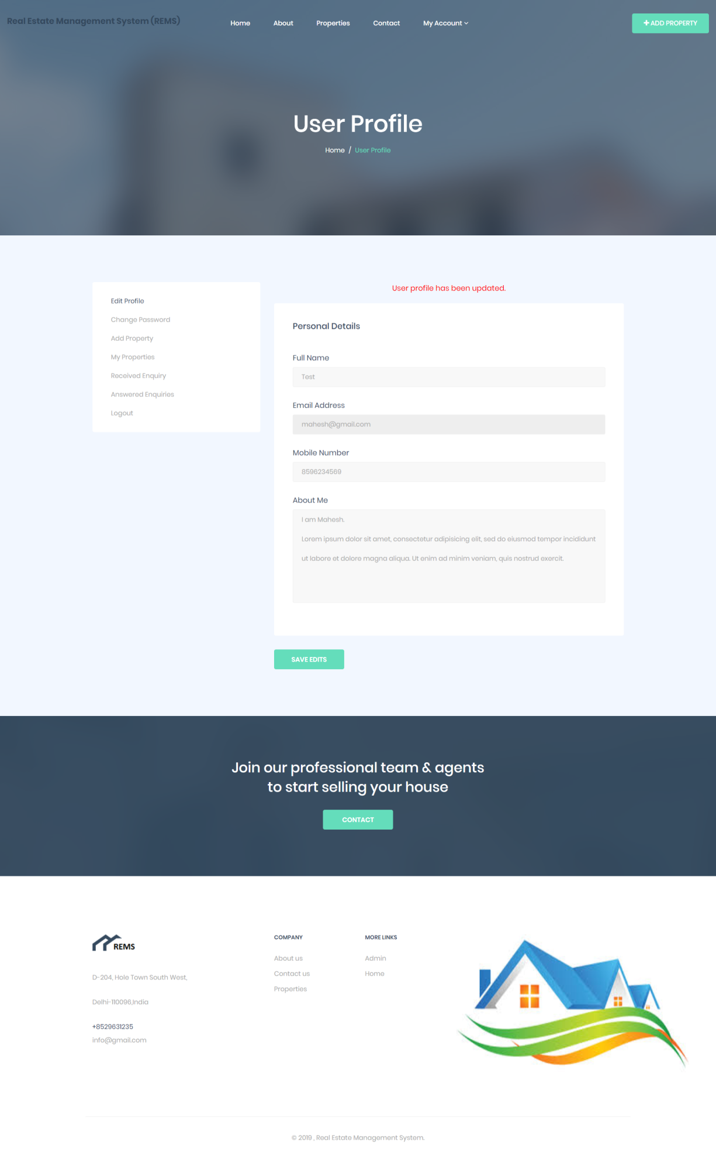
User Profile Page

Slide 40
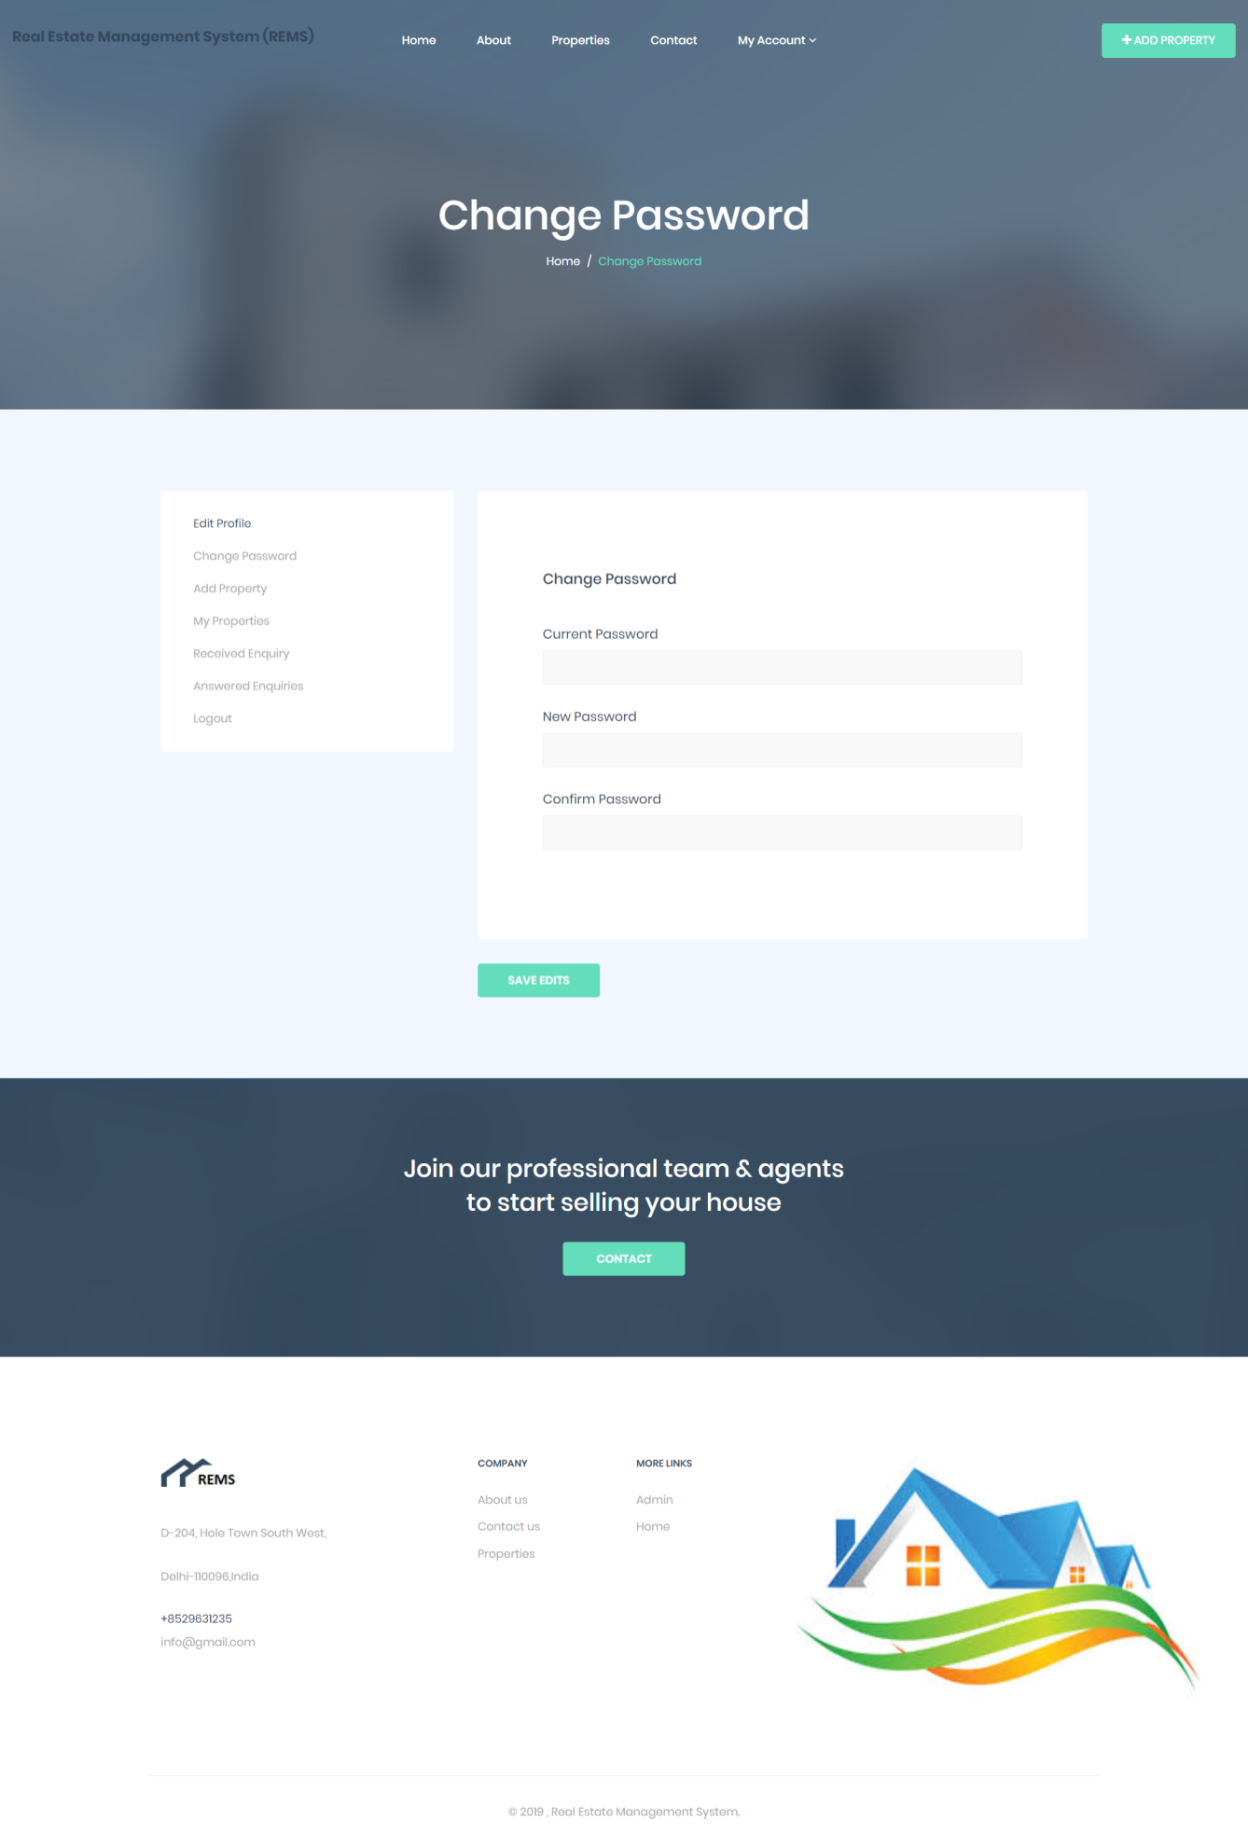
CHANGE PASSWORD PAGE

Slide 41
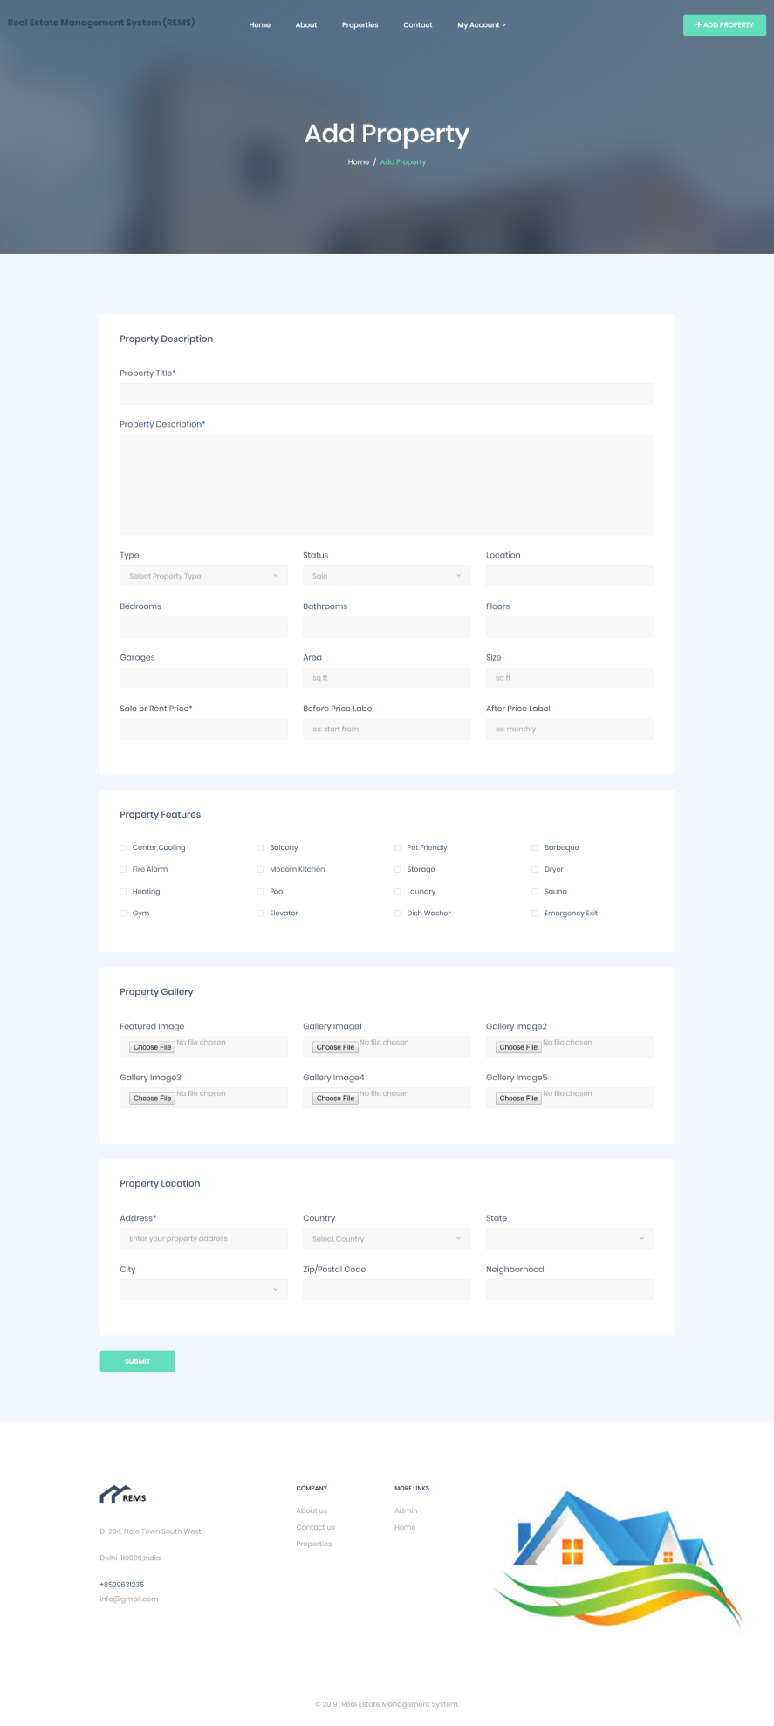
ADD PROPERTY PAGE

Slide 42
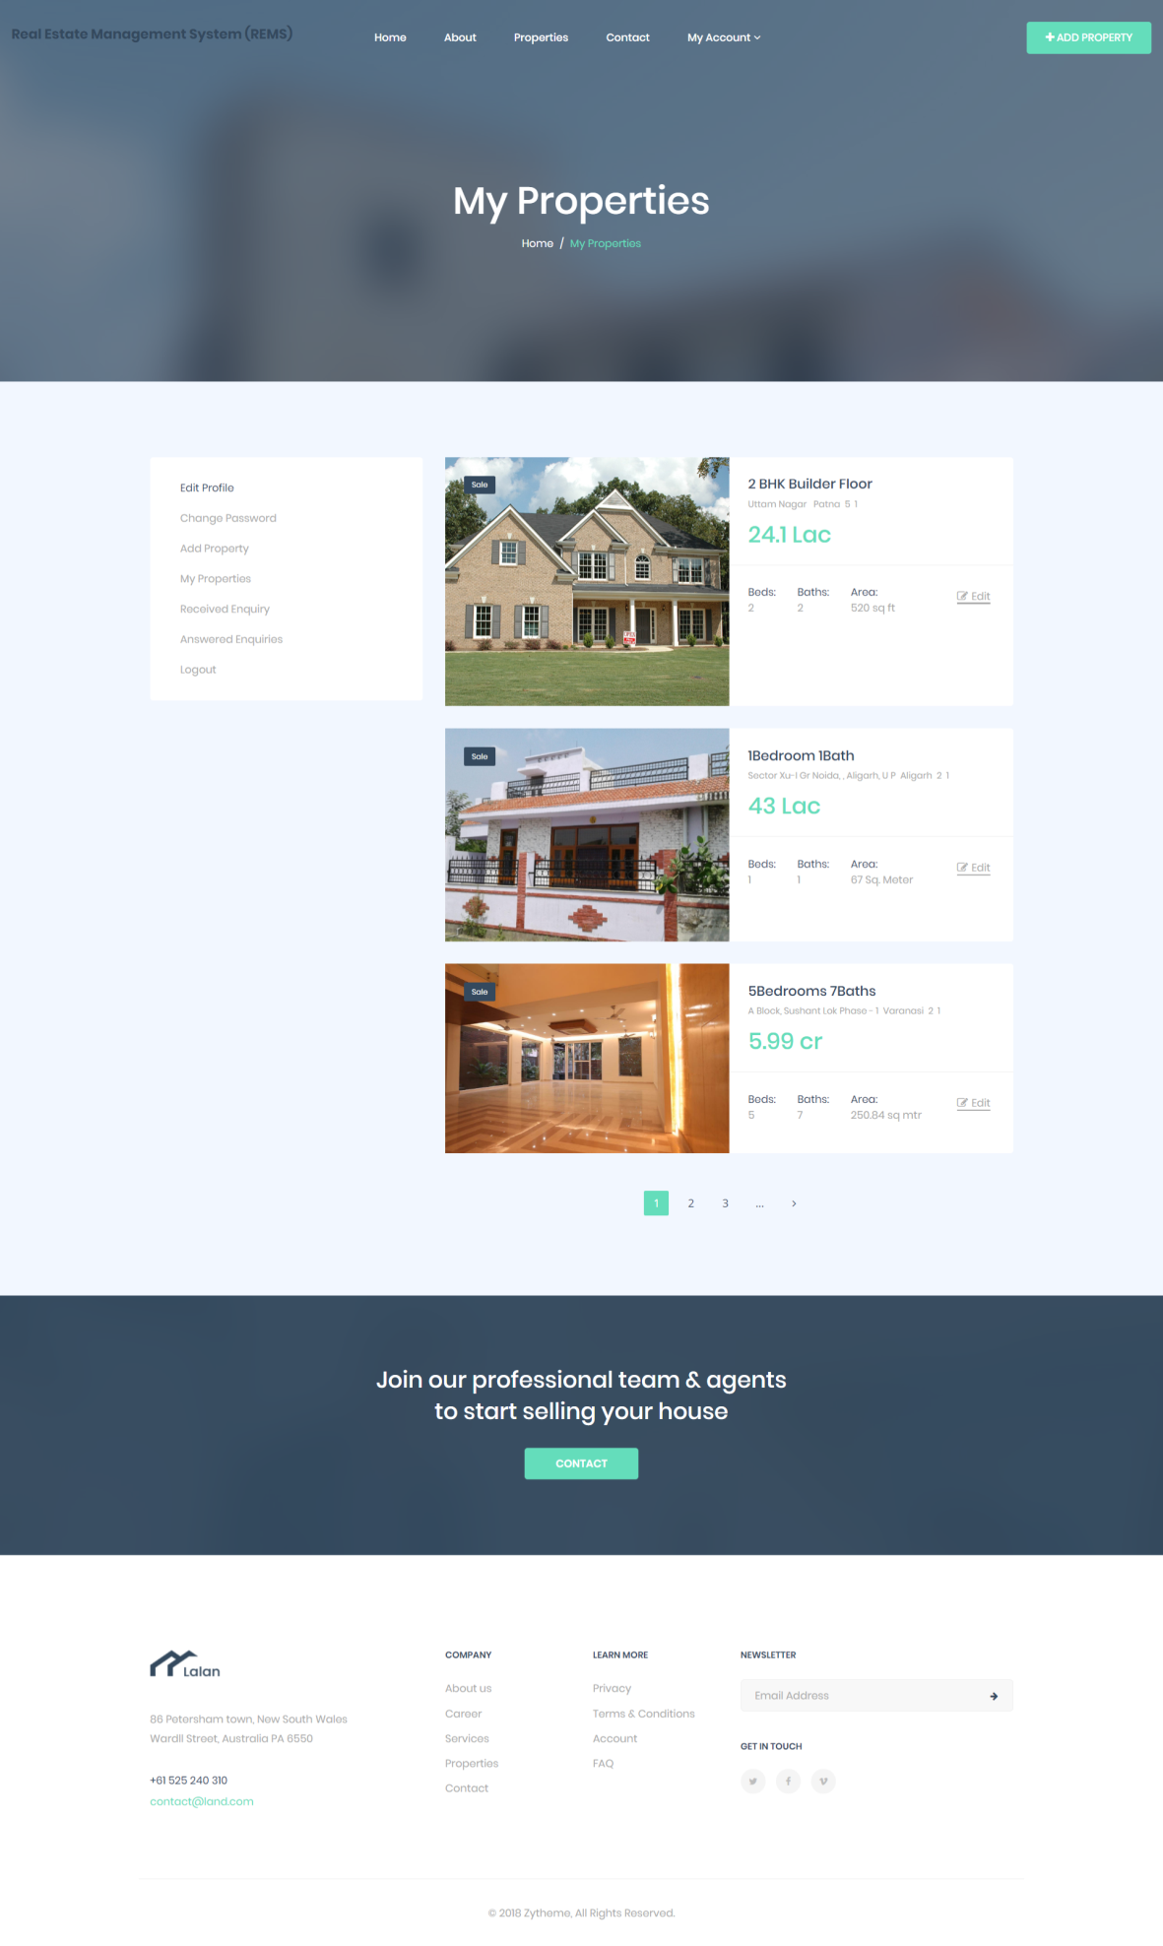
PROPERTY LISTED PAGE

Slide 43
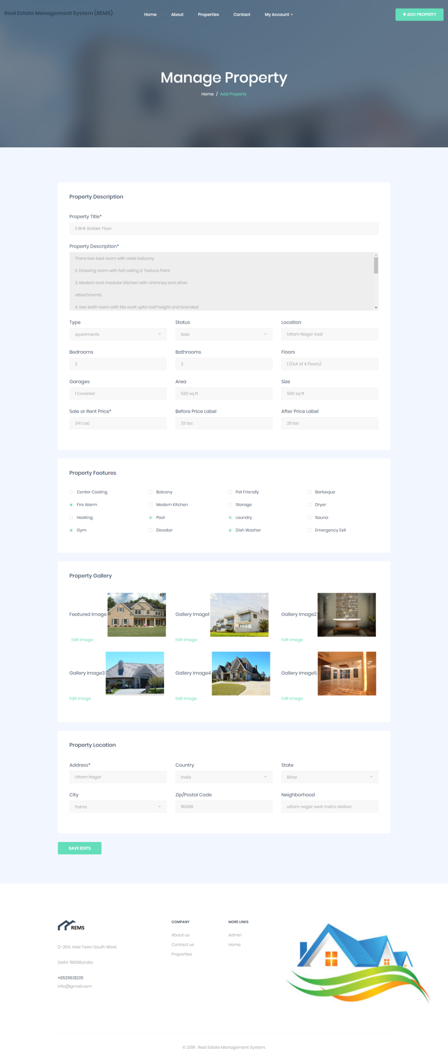
MANAGE PROPERTY PAGE

Slide 44
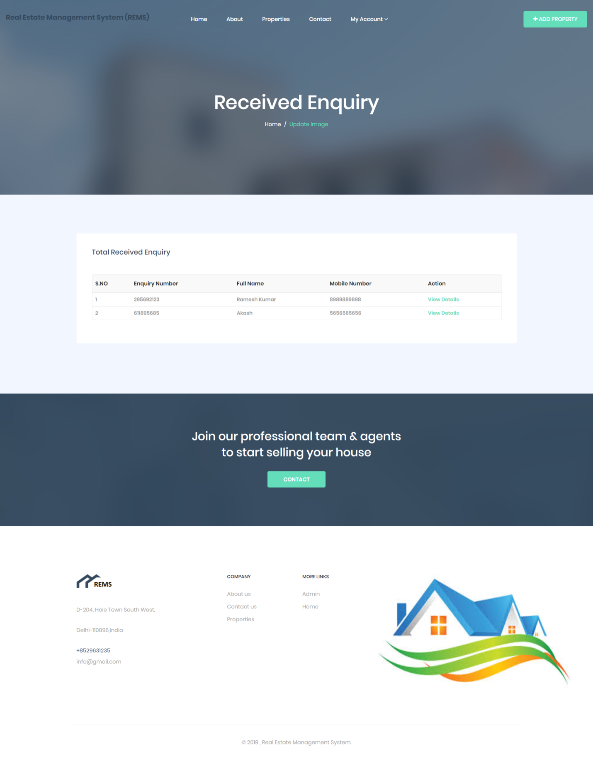
VIEW RECEIVED ENQUIRIES PAGE

Slide 45
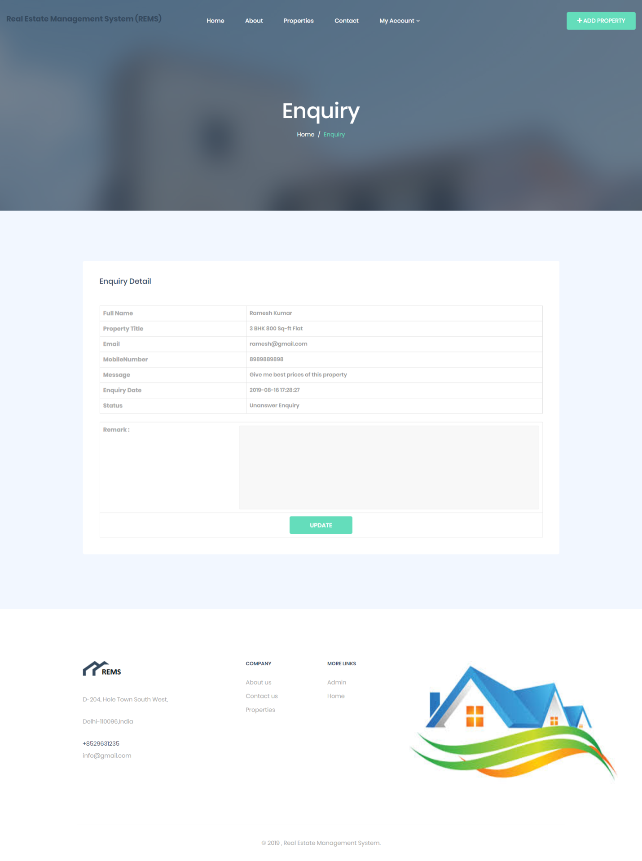
ENQUIRY DETAIL PAGE

Slide 46

VIEW ANSWERED ENQUIRY PAGE

Slide 47
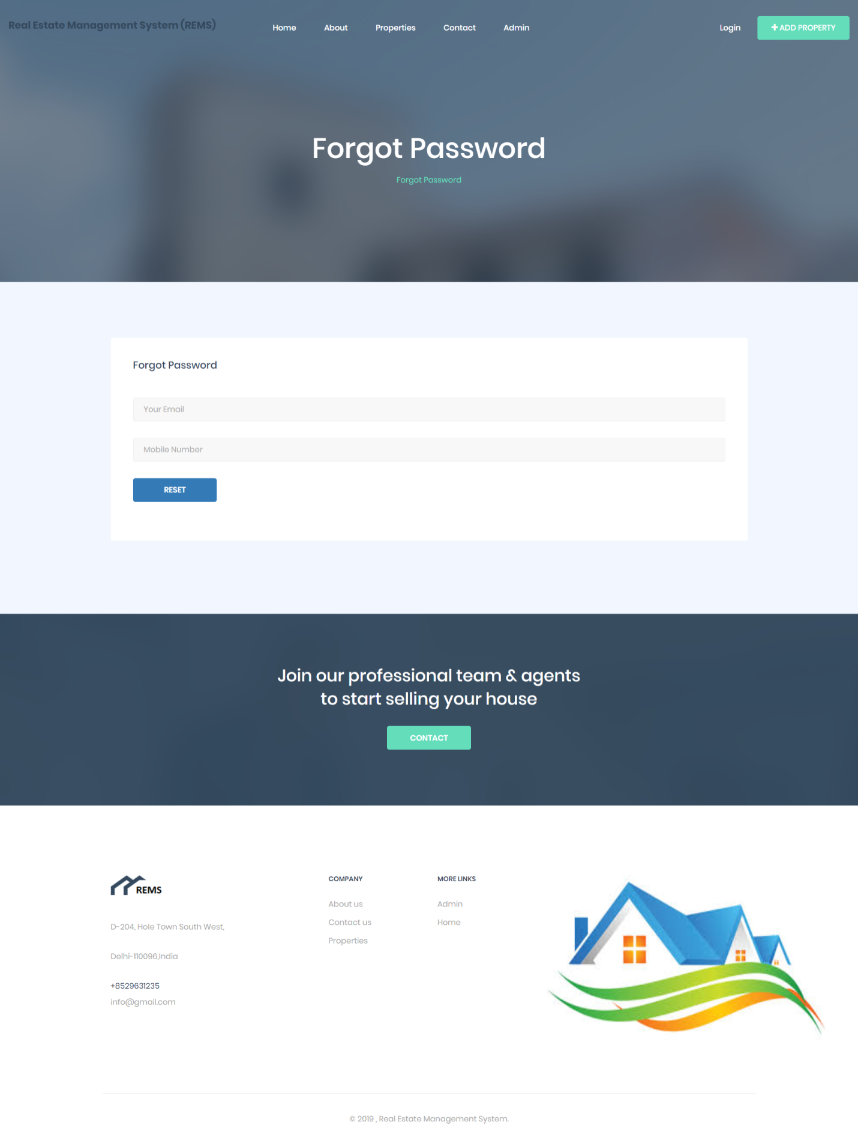
FORGOT PASSWORD PAGE

Slide 48
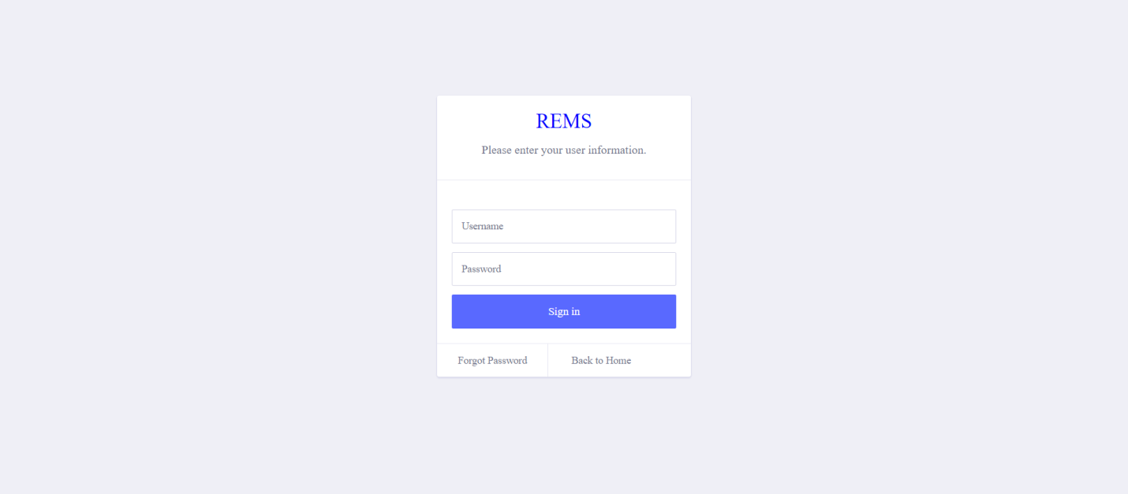
ADMIN LOGIN PAGE

Slide 49
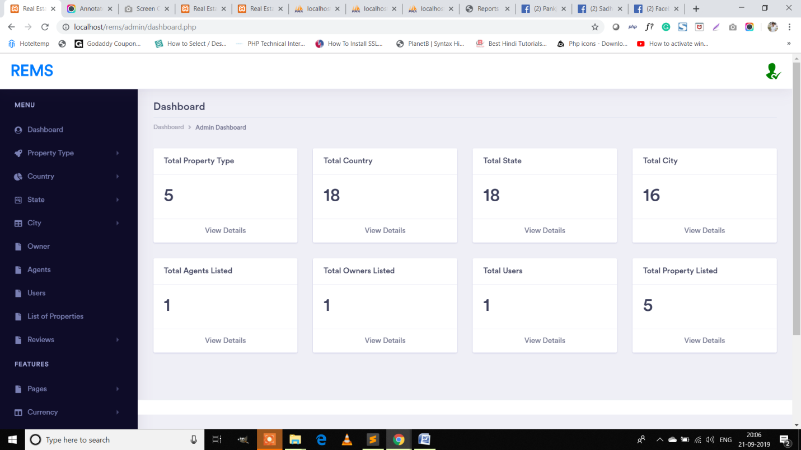
DASHBOARD PAGE

Slide 50
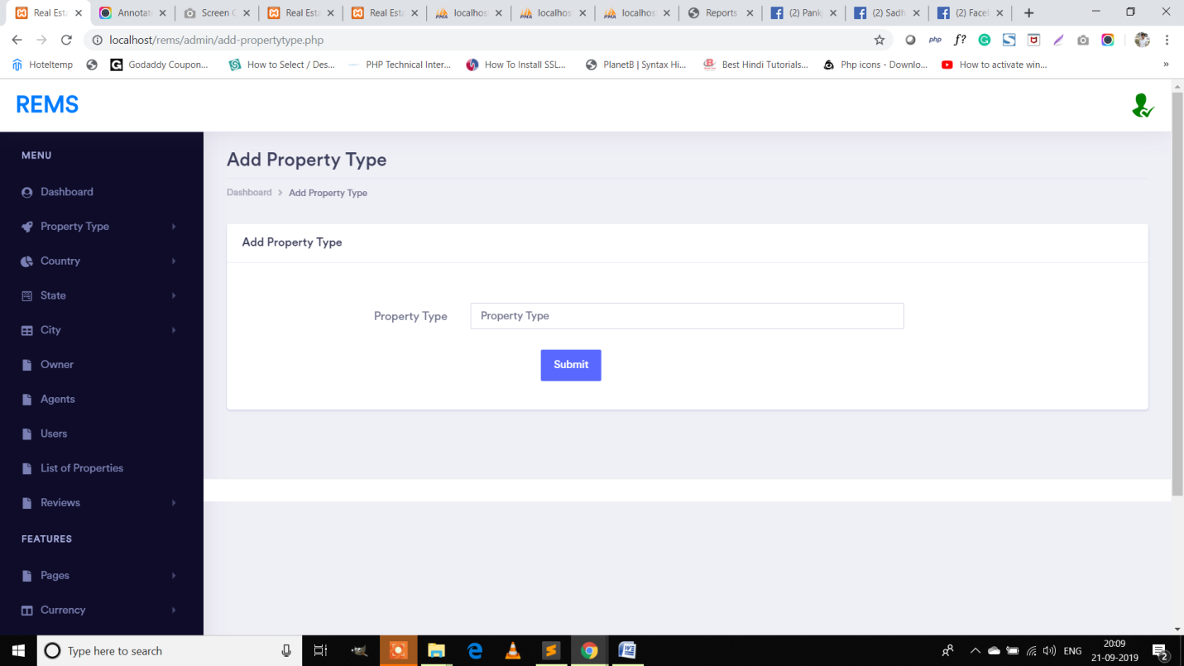
ADD PROPERTY PAGE

Slide 51
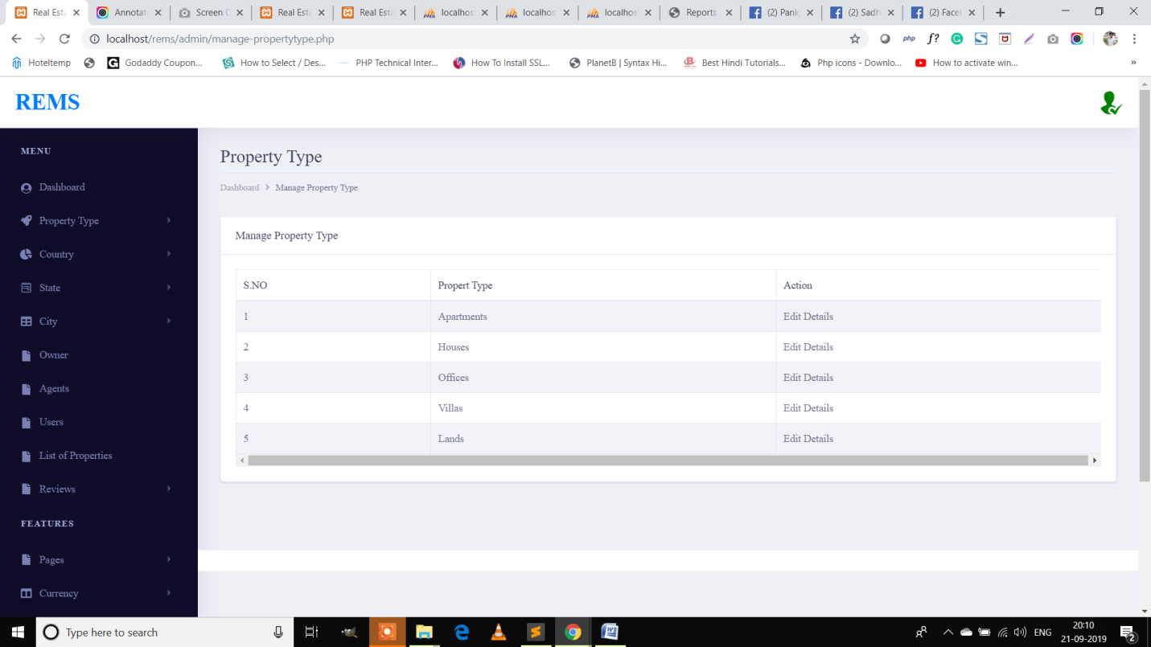
MANAGE PROPERTY PAGE

Slide 52
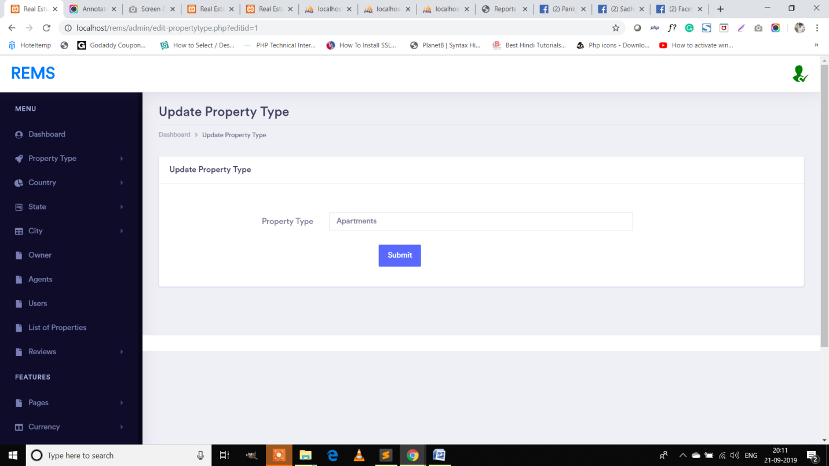
UPDATE PROPERTY PAGE

Slide 53
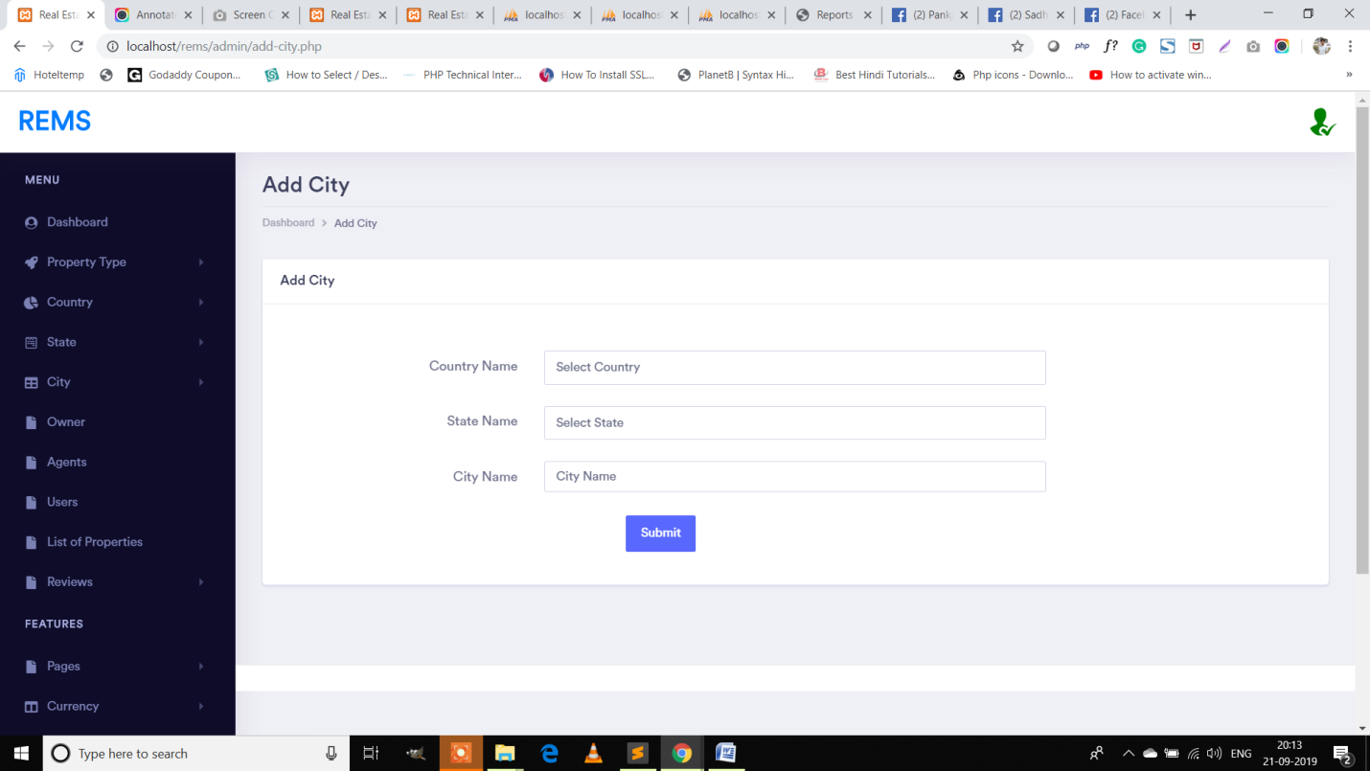
ADD CITY PAGE

Slide 54
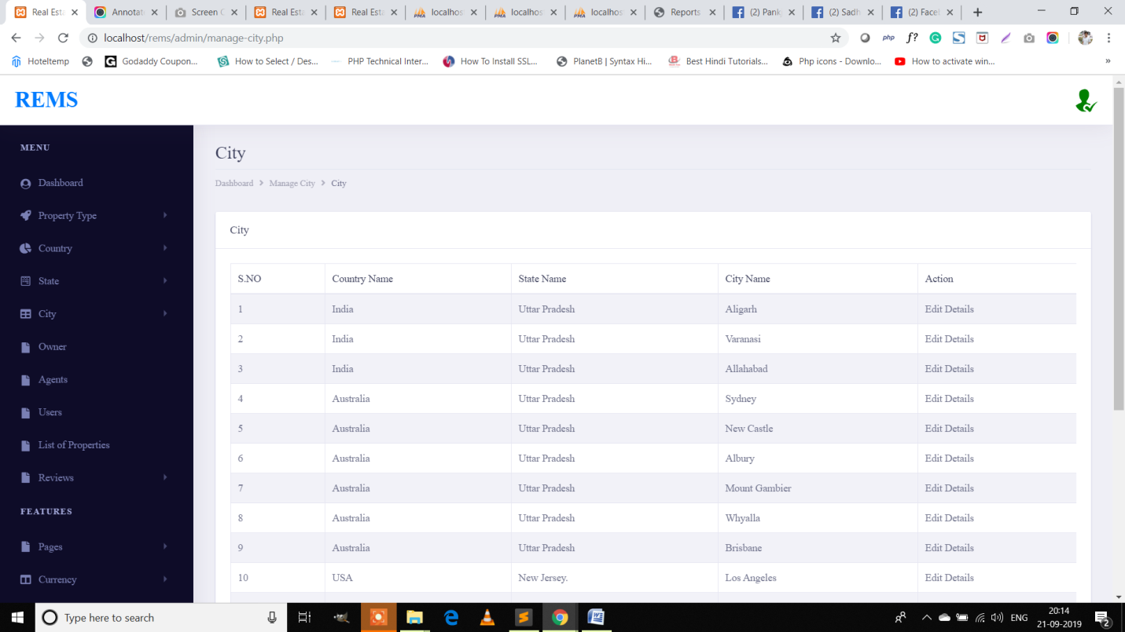
MANAGE CITY PAGE

Slide 55
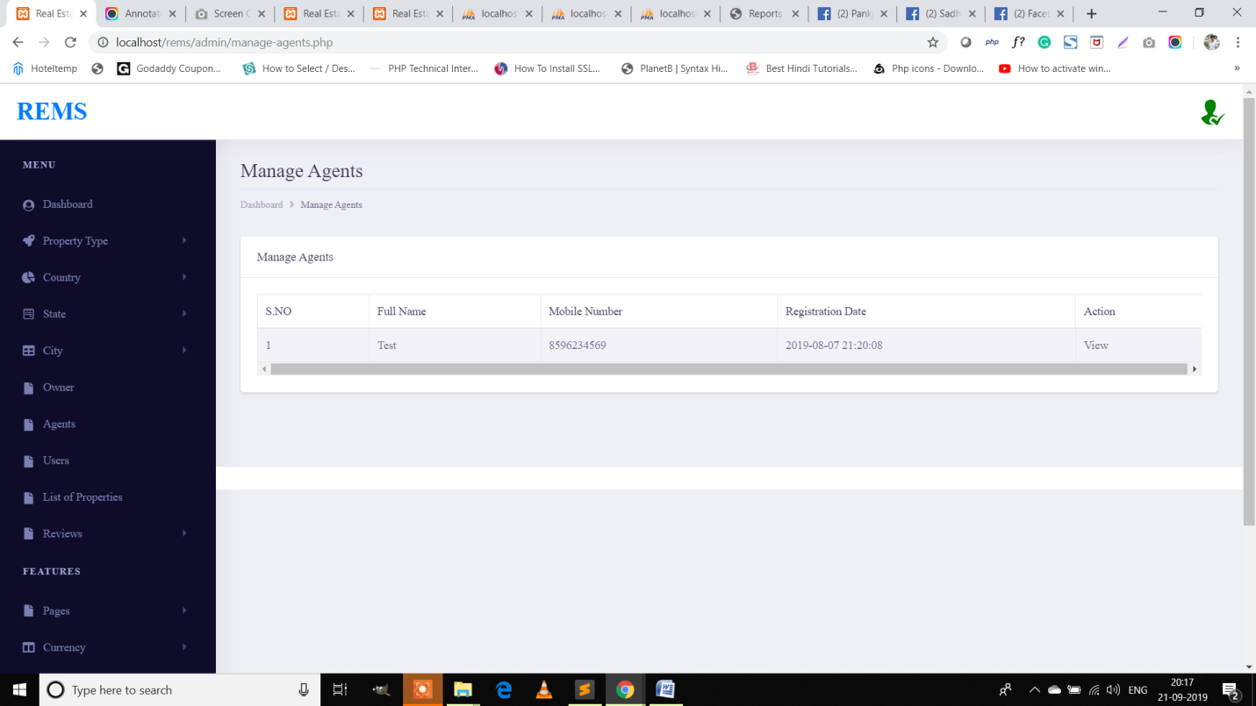
MANAGE AGENTS PAGE

Slide 56

VIEW LISTED PROPERTIES PAGE

Slide 57
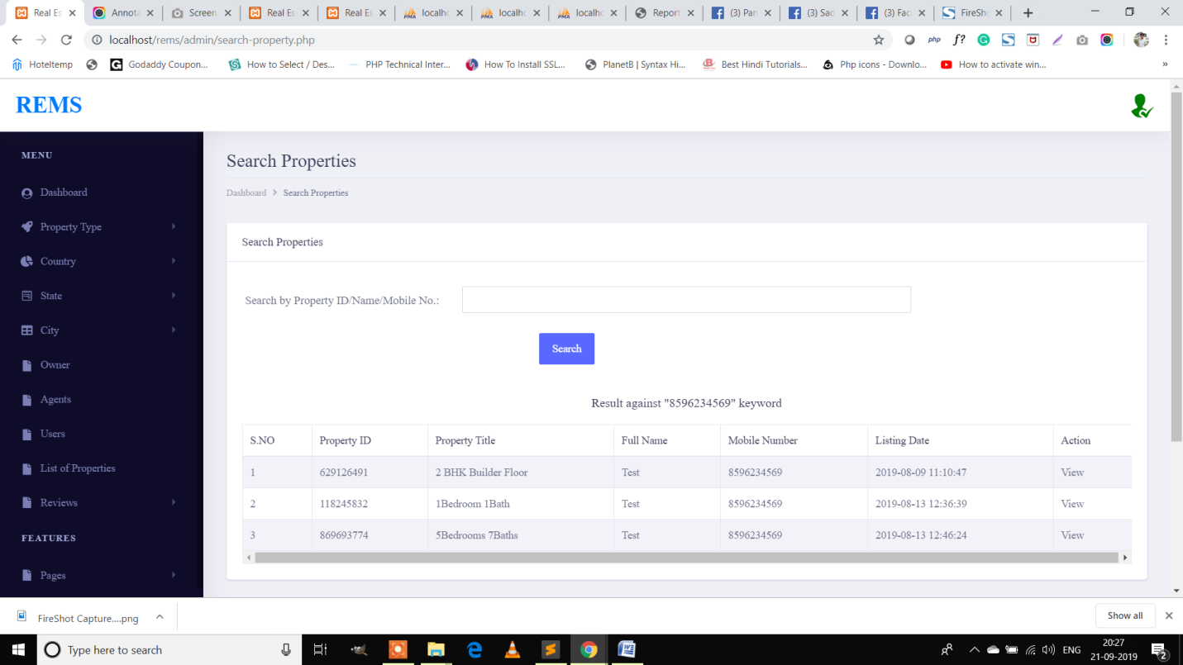
SEARCH PROPERTY PAGE

Slide 58
FUTURE SCOPE
This web application involves almost all the basic features of the real state management system. The future implementation will be online help for the users and chatting with website administrator.

Slide 59
CONCLUSION
It has been a great pleasure for me to work on this exciting and challenging project. This project proved good for me as it provided practical knowledge of not only programming in PHP and MYSQL web based application. It also provides knowledge about the latest technology used in developing web enabled application and client server technology that will be great demand in future. This will provide better opportunities and guidance in future in developing projects independently.

Slide 60
BIBLIOGRAPHY
FOR PHP INSTALLATION
www.php.net
FOR DEPLOYMENT AND PACKING ON SERVER
www.developer.com
www.15seconds.com
FOR MYSQL
www.mysql.com
FOR PHP,CSS,APACHE
www.w3schools.com
www.php.net
www.cssed.sourceforge.net
www.apache.org

Slide 61
THANKYOU

